Slide 1

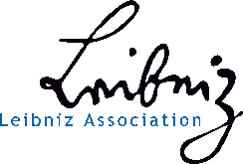

nmrML: An open vendor-neutral data format for NMR
Daniel Schober
Leibniz Institute of Plant Biochemistry
Halle, Germany

Slide 2

A Collaborative Effort
EU
COSMOS
PhenoMeNal
Standards Governance Bodies
MSI
PSI
NMR Vendors
Diverse academic institutions
Europe & North America

Slide 3
Design guidance
Allow vendor-agnostic data sharing
Search & retrieval across platforms
permit spectrum reconstruction & comparison
Facilitate evaluation
data quality assurance & validators
Improve data persistence & archiving
Easy integration with existing software
XML-based, as mzML for mass spec
Controlled vocabulary support

Slide 4

nmrML Overview tool ecosystem

Slide 5





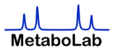








nmrML Workflow oriented Overview
Spectrum Visualisation
Data Deposition
& Storage
JSpectViewer
PMB_NMRviewer
Data Processing
& Quantification
Quality Assurance
Format
Conversion
nmrML Semantic Validator
ISA Validator
Minimal Information checks
Workflow Reproducability
MetaboLights
Batman
Statistics
Metadata Enrichment
MATLAB
nmrML to
nm IO
NmrML-Assign

Slide 6
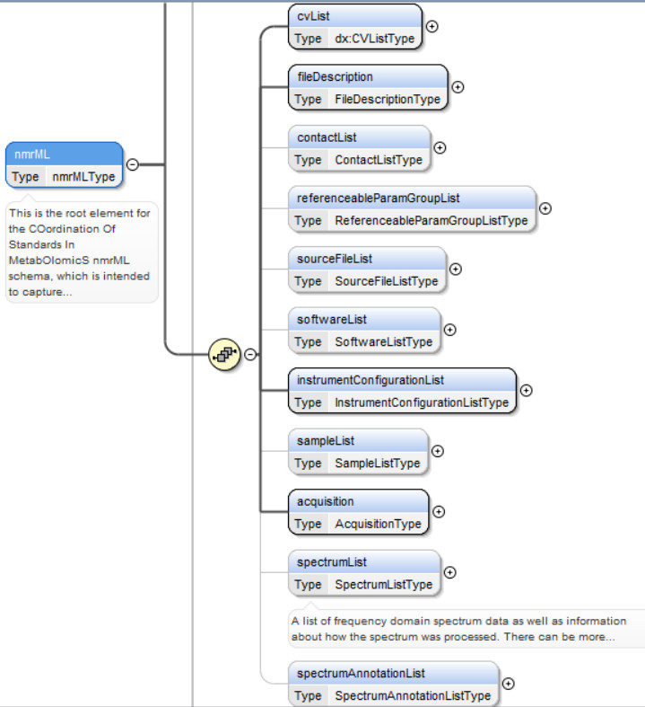
Coverage of nmrML

Slide 7
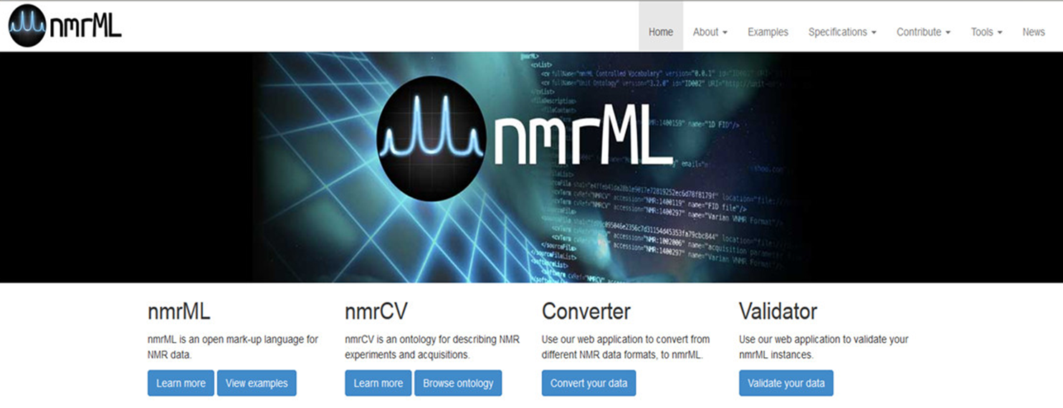
www.nmrML.org

Slide 8
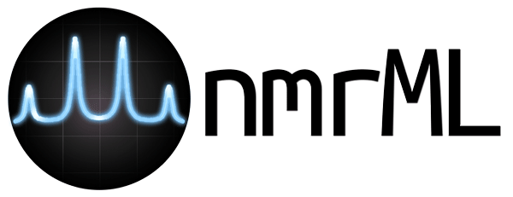
Acquisition Parameter Mappings vendor to nmrML
numberOfScans | NS | nt | total_scans
numberOfSteadyStateScans | DS | ss | x_prescans
sampleAcquisitionTemperature | TE | temp | temp_set
spinningRate | MASR | spin | spin_set
relaxationDelay | D1 | d1 | relaxation_delay
pulseSequence | PULPROG | seqfil | experiment
numberOfDataPoints | TD | np | x_points
acquisitionNucleus | NUC_1 | tn | x_domain
sweepWidth | SW_H | sw | x_sweep
pulseWidth | P1 | pw | x_pulse
irradiationFrequency | SF01 | sfrq | x_freq
decouplingNucleus | NUC_2 | dn | -

Slide 9
Expressivity in different use cases
Things you can do …
Example 1: minimal Agilent FID raw data capture plant extract
Example 2: raw data & processed Bruker 1R spectrum
Example 3: single (HMDB) reference compound & complete atom-to-peak annotation (NMR Assign)
Example 4: complex biosample & quantification for identified molecule list (Bayesil)
Example 5: MTBLS1 dataset from Metabolights
Example 6: 2D NMR spectrum capture for HSQC

Slide 10
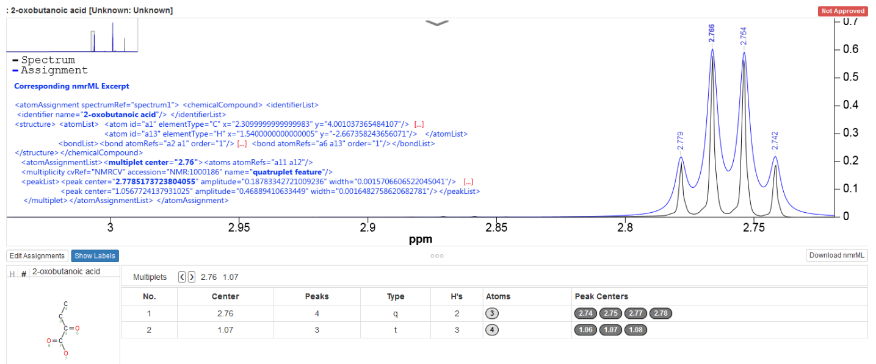
Peak-to-Atom Assignment in nmrML-Assign Example 3: HMDB Reference Compound
JSpectraViewer on Bayesil Result
CMLSpect
quatruplet

Slide 11

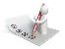




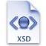

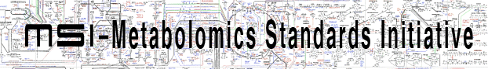

Data Validations for Quality Assurance
XML Syntax
Structural validity of nmrML XML instances
Semantic validity of CV term usage
Minimum Information Standard compliance
e.g. CIMR Core Information for Metabolomics Reporting
Journal Policy compliance

Slide 12
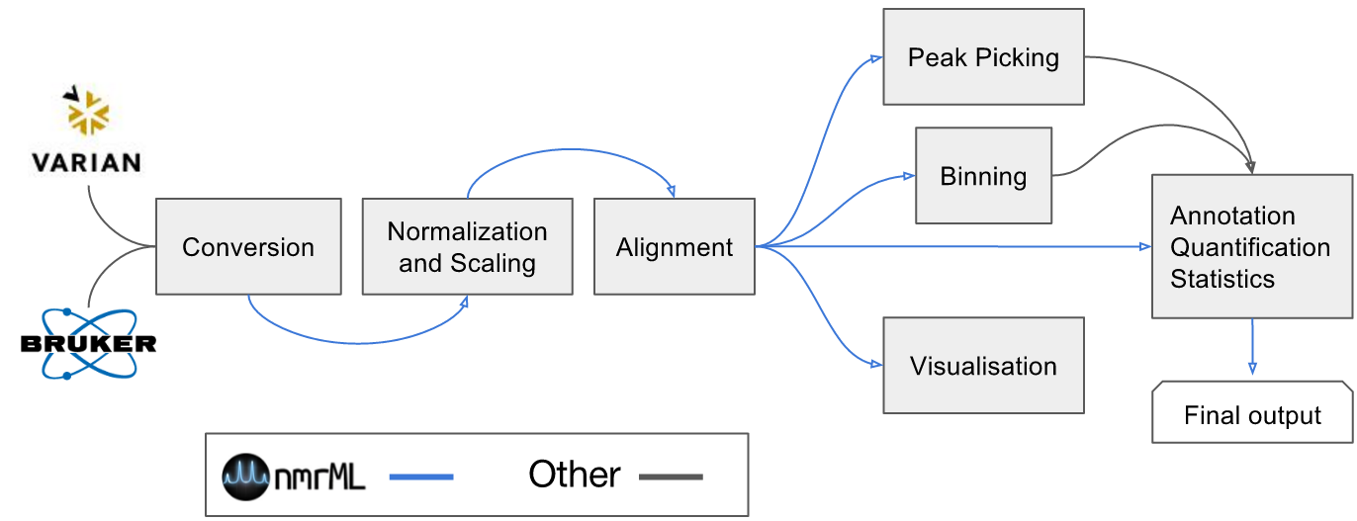
nmrML supporting workflows tameNMR

Slide 13
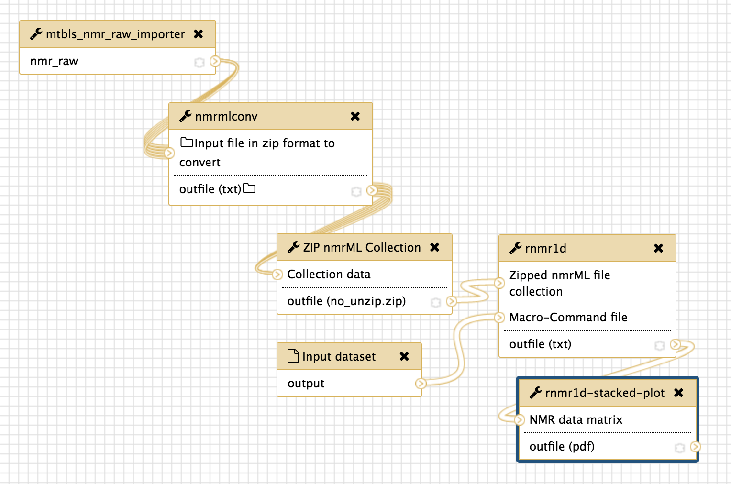
Repeatable Galaxy Workflows NMR preprocessing
[screenshot rNMR Galaxy WF]

Slide 14
Summary
… a FAIR contribution

Slide 15
Resources
Website
www.nmrml.org
Git Repo
https://github.com/nmrML
Paper
ACS AC DOI: 10.1021/acs.analchem.7b02795
Tutorial Films
https://www.youtube.com/channel/UC-QDAWEByM-Q_QfTZC-Gftw
Discussion Forum
https://groups.google.com/forum/?hl=en#!forum/nmrml/join
Email
info@nmrml.org

Slide 16

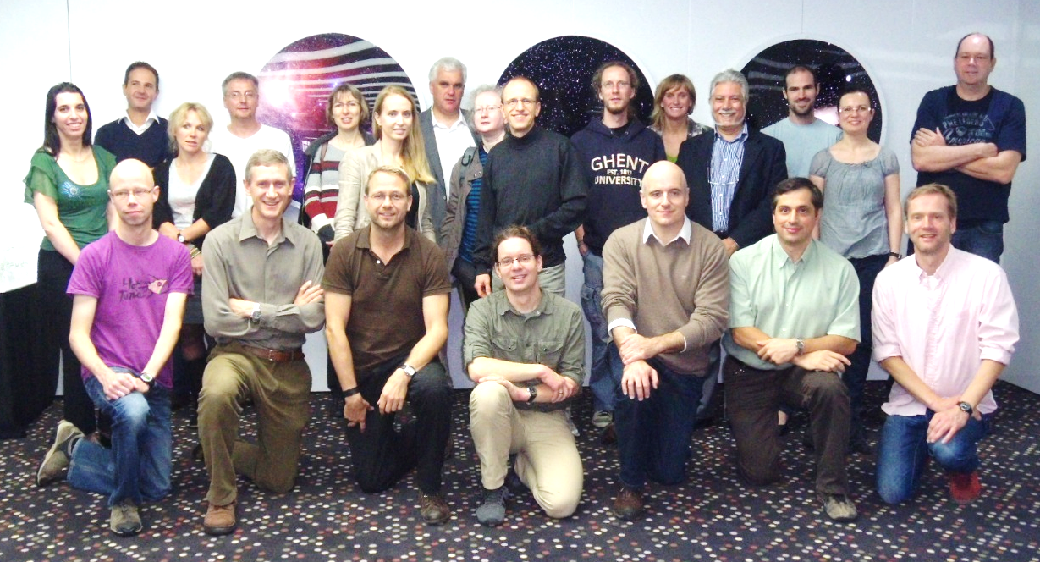



Acknowledgements
nmrML: a community supported open data standard for the description, storage, and exchange of NMR data
Daniel Schober^{1,*}, Daniel Jacob², Michael Wilson³, Joseph A. Cruz³, Ana Marcu³, Jason R. Grant³, Annick Moing², Catherine Deborde², Luis F. de Figueiredo⁴, Kenneth Haug⁴, Philippe Rocca-Serra⁵, John Easton⁶, Timothy M. D. Ebbels⁷, Jie Hao⁷, Christian Ludwig^{8a}, Ulrich L Günther^{8b}, Antonio Rosato⁹, Matthias S. Klein¹⁰, Ian A. Lewis¹⁰, Claudio Luchinat⁹, Andrew R. Jones¹¹, Arturas Grauslys¹¹, Martin Larralde¹², Masashi Yokochi¹³, Naohiro Kobayashi¹³, Andrea Porzel¹⁴, Julian L. Griffin¹⁵, Mark R. Viant¹⁶, David S. Wishart³, Christoph Steinbeck⁴, Reza M. Salek^{4*} and Steffen Neumann¹
EU FP7 project COSMOS grant EC312941
EU Horizon 2020 PhenoMeNal grant 654241

Slide 17

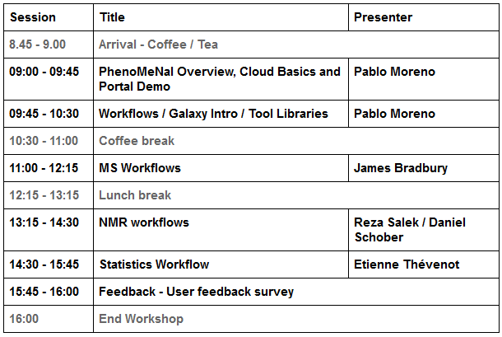

FREE Workshop: See nmrML in action

Slide 18











Standing on the shoulders of Giants

Slide 19
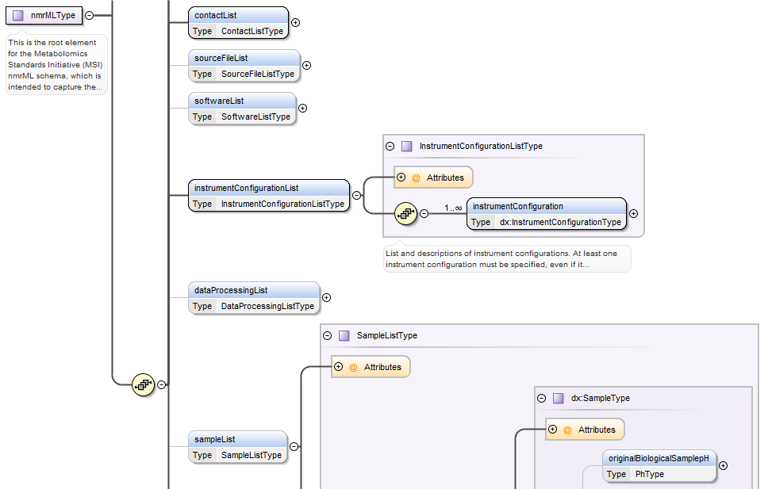
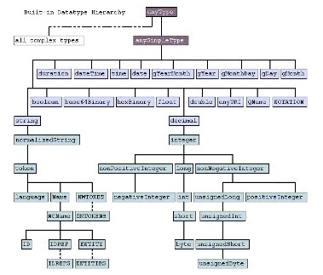

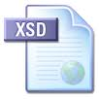
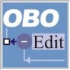

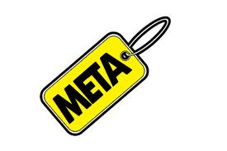
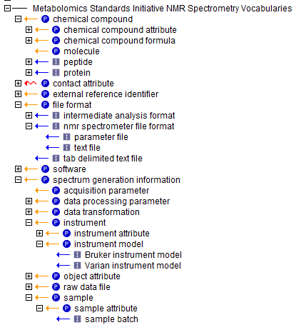
nmrML combines xsd datatypes & CV terms in one XML file
xsd elements
& attributes
xsd datatypes
Stable experimental & raw data
Variant terminological & contextual data
nmrCV terms

Slide 20
When to use CV descriptors
The terms are unstable, variant & dynamically evolving, or need to be changed and updated often. E.g. referring to fast paced changing terms such as software names/versions, processing parameters etc. This means that the terms are better maintained by a fast reacting NMR user community rather than by resource-limited Cosmos work packages.
The terms describe contextual metadata, rather than concrete NMR raw data, i.e. for cases where the terminology is already extensively defined in existing ontologies or CVs.
The terms represent search attributes for data querying and large scale database-integration in an open linked data fashion.
The terms should be exploited by profiting from robust subsumption, e.g. exploiting the taxonomic CV backbone to generalize over query attributes and hence increase result recall and precision. Or the terms should be accessible to rule-based or other reasoning techniques and validation.

Slide 21
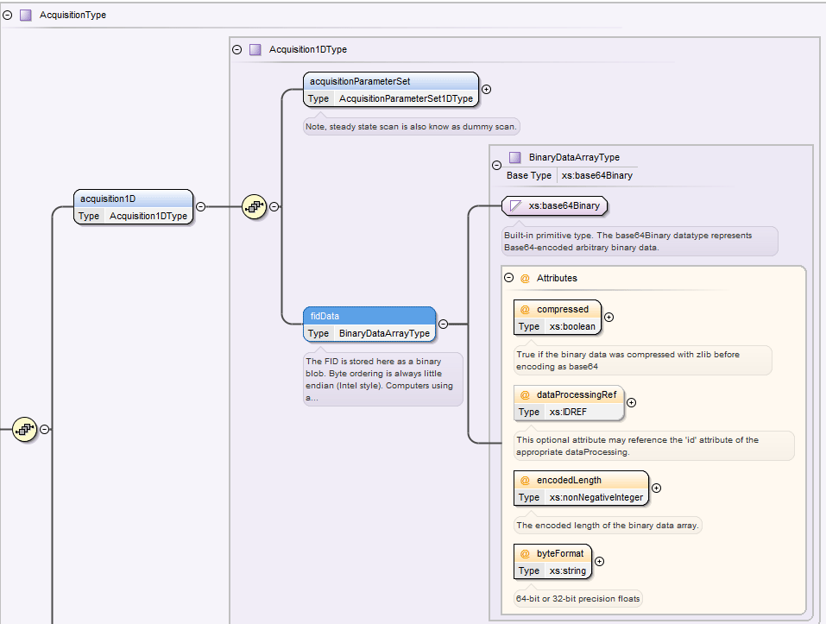
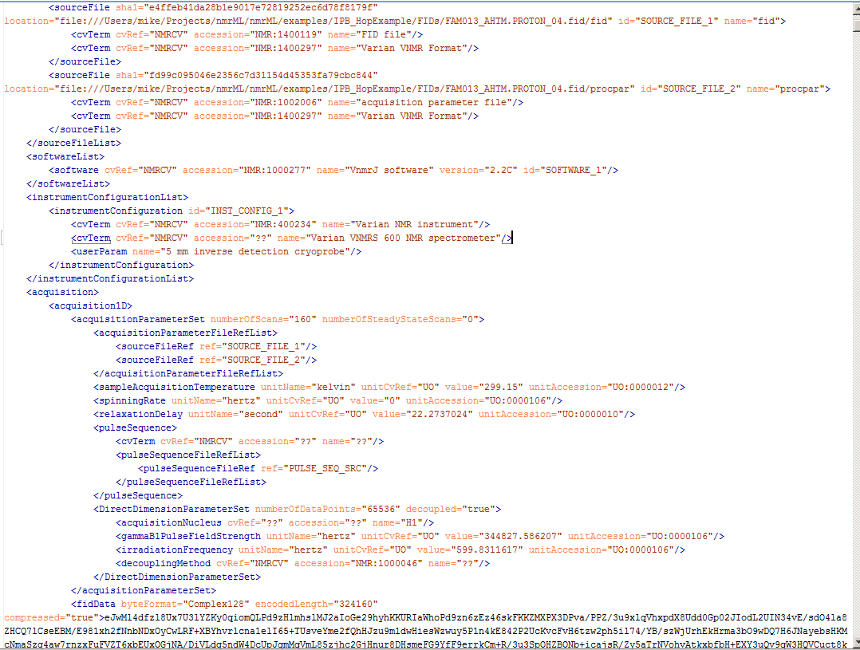
nmrML Schema instantiation (Hop FID data example)
nmrML.xsd
HopExample.nmrML
The FID is stored as a binary blob (base64 encoded binary data). Byte ordering is always Intel-style little endian. Computers using a different endian style must convert to/from little endian when writing/reading nmrML. The FID should be converted into a Complex64 array before encoding, but is Complex128 in this case.

Slide 22
Basic Elements in nmrML
‘cvList’ defines the controlled vocabularies from which terms are drawn in the XML data file. This allows tools to look-up additional CV metadata, and even the complete taxonomic (is_a) hierarchy of a term. Traversing root-wards in a taxonomy is called abstraction, traversing leaf-wards is called specialisation or subsumption.
‘fileDescription’ allows the CV based description of the nmrML file itself which allows for easy categorization of different types of nmrML instances e.g. 1D vs. 2D NMR data sets. This is expected to aid processing software in skipping files that do not contain appropriate spectrum types for it.
‘contactList’ captures information that allows one to contact the original creators/corresponding authors of a file/paper in the case that further clarification is needed.
‘sourceFileList’ captures attributes like name, ID, location and CV descriptors for the original NMR raw data files that were used to generate the nrmML file. This includes files that were required during the acquisition of the spectrum, for example a Varian processing parameter file or a source code file for a pulse program.
‘softwareList’ captures references to software that was used during data acquisition and processing, and may include several different pieces of software.
‘informationConfigurationList’ contains information about the configuration of an instrument beyond the acquisition parameters, for example the brand and model of the instrument.
‘dataProcessingList’ captures the list and order of software applied together with their respective processing methods by means of CV based descriptions.
‘sampleList’ captures lists of NMR samples by means of their solvent properties, buffer, pH value, chemical shift and concentration standards used.
‘referenceableParamGroupList’ allows to capture a multiplicity of CV descriptions to be identified and re-used again throughout an nmrML file to avoid redundancy.
‘acquisition’ captures the processing parameters used during the acquisition (see below). Since vendors have their own set of names for each of these parameters, we have standardized them with hopefully intuitive clear names. This element also contains the captured FID raw data.
‘spectrumList’ contains one or more spectra in the frequency domain.

Slide 23
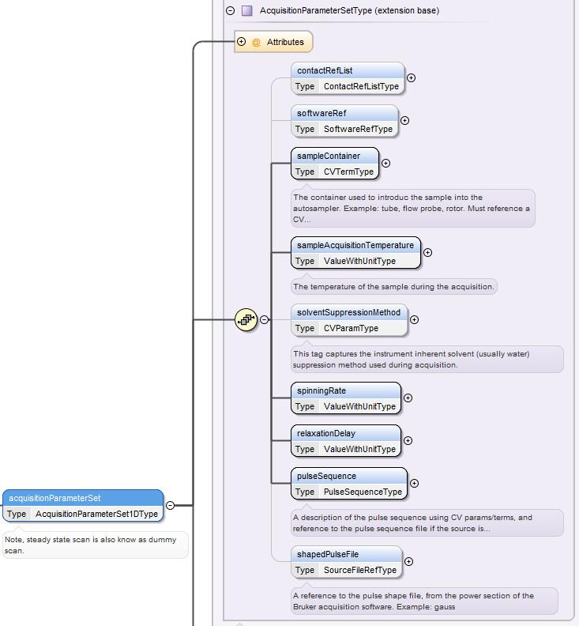
nmrML acquisition data

Slide 24
6 Examples
Example 1: A hop metabolite profiling experiment (Varian/Agilent), raw FID data
This spectrum is from a metabolomic profiling experiment Humulus lupulus L.It shows how a minimal nmrML file as generated by the Vendor to nmrML converter looks like. It just contains the raw data (FID) and no processed data/spectrum. The spectrum was recorded on a Varian VNMRS 600 NMR spectrometer operating at a proton NMR frequency of 599.83 MHz using a 5 mm inverse detection cryoprobe. 1H NMR spectra were recorded with the following parameters: digital resolution 0.367 Hz/point (32 K complex data points); pulse width (pw) = 3 ls (4°C); relaxation delay = 23.7 s; acquisition time = 2.7 s; number of transients = 160. Find more in the paper at http://link.springer.com/article/10.1007%2Fs11306-013-0547-4
Example 2: Metabolic profiling of the Tomato plant, PhenoTom 2013 (Bruker), including a processed spectrum
This spectrum is from a metabolomic profiling experiment onLycopersicon esculentum. Besides the FID it contains the Bruker 1R spectrum (real part data points) after FT processing. This example illustrates how nmrML can include processed data beyond the raw FID data. We here store a 1R NMR spectrum (as another binary blob) and including its metadata. The FT transformed spectrum is stored in the spectrumList/spectrum1D/spectrumDataArrayelement and its processingParameterSets. The spectrum was recorded at 500.162 MHz on a Bruker Avance III spectrometer using a 5 mm probe flushed with nitrogen gas and an electronic reference for quantification (ERETIC2).
Example 3: An HMDB reference spectrum for a single identified molecule, created with nmrML-Assign
This spectrum is a reference spectrum for a single substance, 2-Ketobutyric acid (HMDB00005). Here, for each atom environment in the molecule, detailed atom assignments have been made for the spectral peaks using nmrML-Assign, which is an interactive tool for creating reference spectra and generating nmrML-formatted files. It is an example that illustrates how identification metadata can be stored along a spectrum in nmrML.
Example 4: A complex biosample spectrum (Varian) quantified with Bayesil
This biosample spectrum of a compound mixture (analytical metabolomics setting) was processed with Bayesil. The nmrML format of results from Bayesil contains a list of compounds and peak assignments from the quantification process and exemplifies how nmrML can be used to store quantification metadata alongside a complex spectrum.
Example 5: Human urine sample spectra from the MTBLS1 study
These spectra of human urine samples are part of the MTBLS1 study archived in the MetaboLights database. It serves as an example to illustrate the case of an autoconverted file taken from a database.
Example 6: A example of a 2D nmrML formatted file representing a heteronuclear (HSQC) experiment
nmrML file for a heteronuclear experiment. The data represents the bmse00400-exp06 (HSQC) data set from PDBj-BMRB. The substance under investigation is ethanesulfonate (http://bmrbdep.pdbj.org/bms/bmse000400) (exp06: 2D [1H,13C]-HSQC)

Slide 25
Spectrum Annotation
Capture coarse-grained spectral assignment data for molecule identification and quantification in chemical mixtures
Capture fine-grained assignment and chemical structure data of pure-compound spectra for use in organic synthesis and natural product studies, medicinal chemistry and reference NMR spectral libraries

Slide 26
nmrML code example for Peak assignment
<spectrumAnnotation>
<compound compoundName="alanine" compoundId="CHEBI:16449" >
<atomArray>
<atom id="a1" elementType="C" x2="0.6667733333333334" y2="-0.38490666666666673"/>
<atom id="a2" elementType="C" x2="-0.6667733333333334" y2="-1.1550933333333335"/>
…
<atom id="a8" elementType="H" x2="-1.2303901544895832" y2="0.9487051800384392"/>
<atom id="a9" elementType="H" x2="-3.3341185133717732" y2="0.3852098455104175"/>
<atom id="a10" elementType="H" x2="-2.770623178843752" y2="-1.7185185133717726"/> …
</atomArray>
<bondArray>
<bond atomRefs2="a1 a2" order="1"/>
<bond atomRefs2="a2 a3" order="1"/>
<bond atomRefs2="a1 a4" order="2"/>
…
</bondArray>
</compound> <multiplet center="1.04" >
<equivalentHydrogens atomRefs="a8 a9 a10"/>
<multiplicity cvRef="NMRCV" accession="NMR:1000185" name="triplet feature"/>
<peaks>
<peak center="1.03" amplitude="514.0" />
CML inspired Molecule Structure
Spectral Annotation

Slide 27
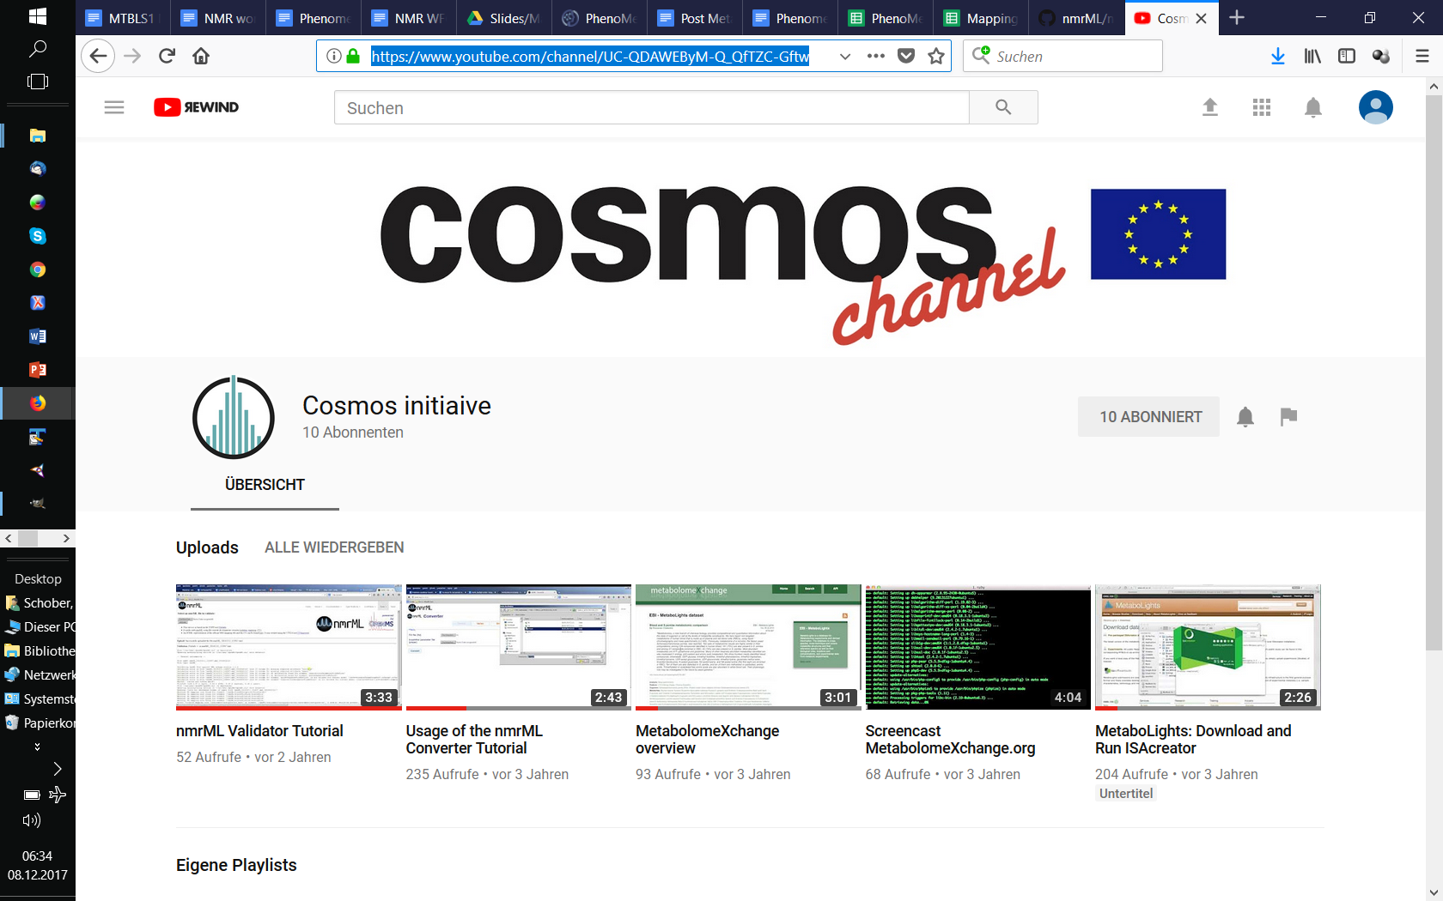

Slide 28
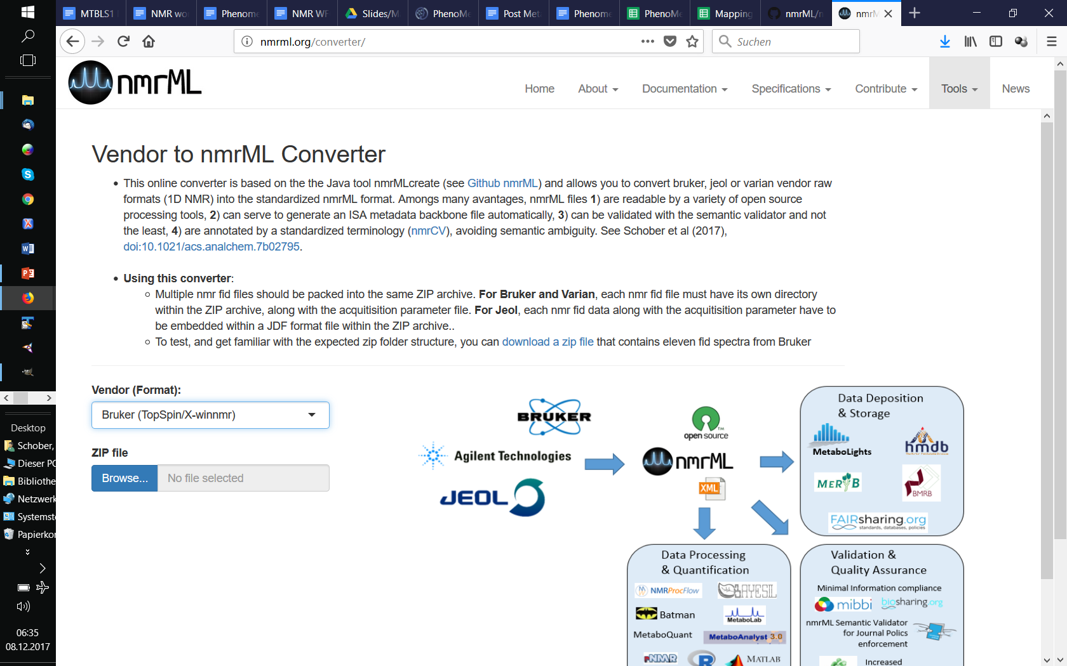

Slide 29
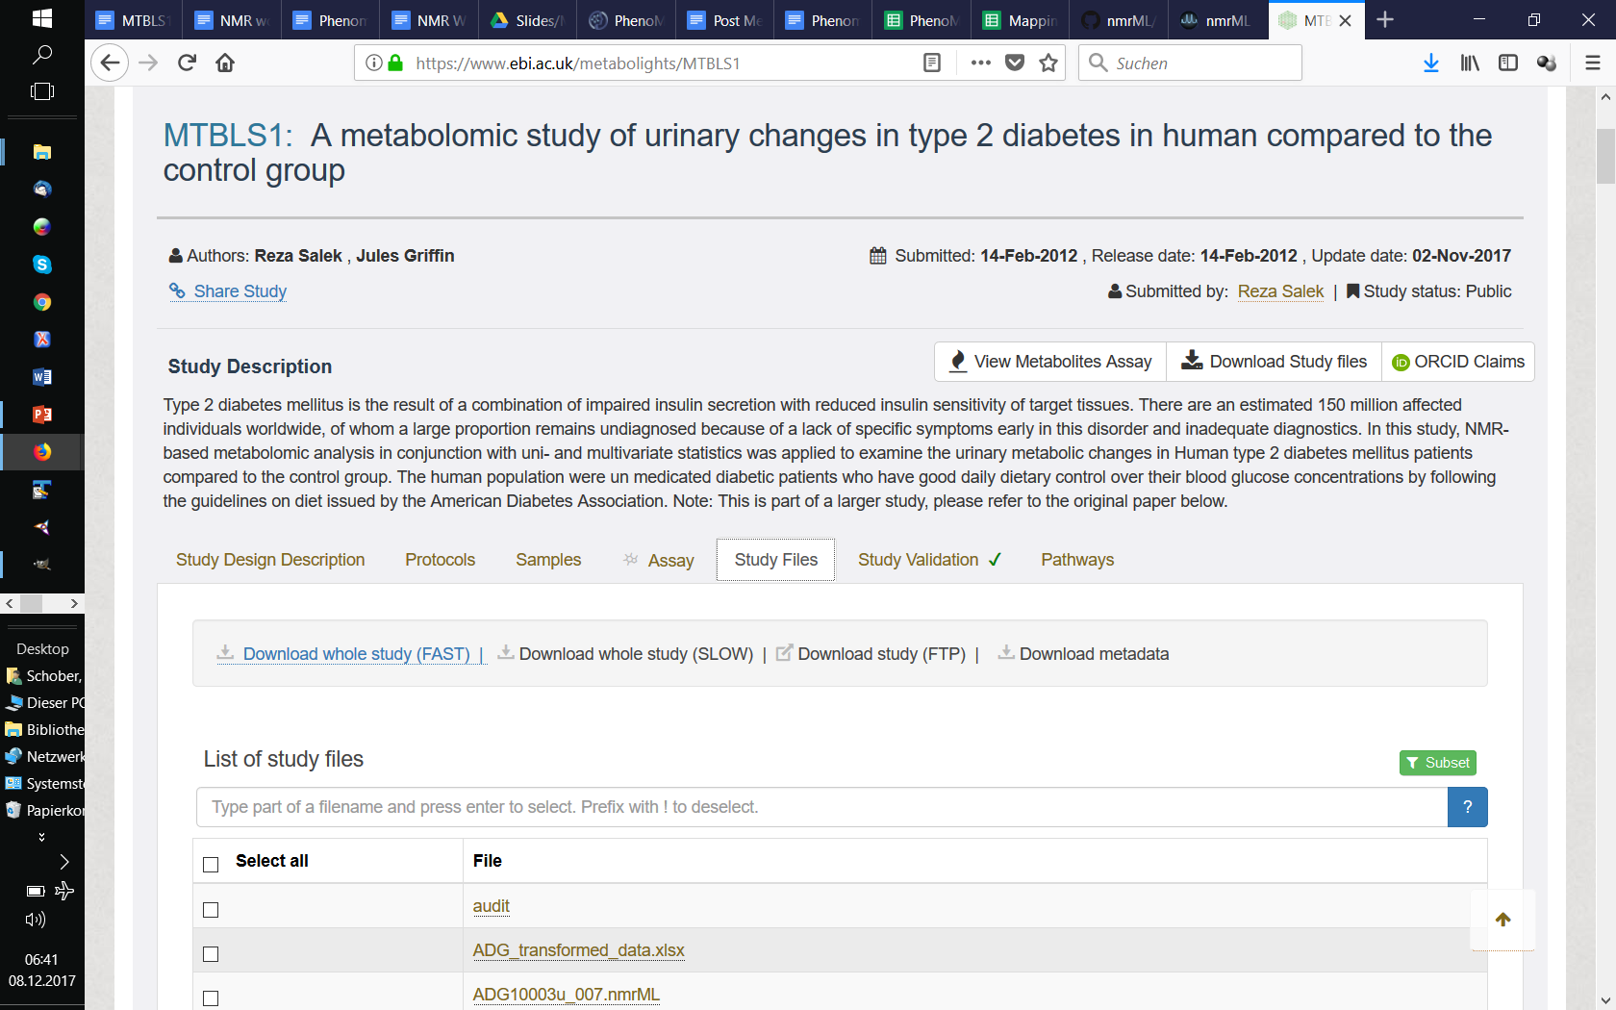
MTBLS1

Slide 30
